Slide 1
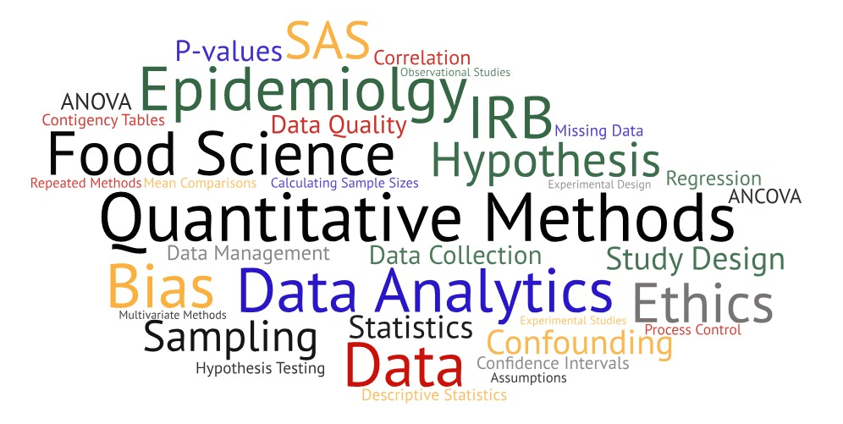
One Health Summer Institute Introduction to Data Analytics, Statistics & Programming in Epidemiologic Research
Introduction

Slide 2
Participant Introductions

Slide 3
Course Objectives
Introduction to principles of data analysis, including data cleaning, quality checking and visualization, statistical analysis and handling large datasets.
Course objectives:
Provide guidelines for best practice in reproducible research;
Provide attendees with a core set of working code, with example data, so that they can readily apply it to their own data;
Provide attendees with the ability to analyze publicly available data.

Slide 4
Course Schedule
 | Day 1 | Day 2 | Day 3 | Day 4
9:00 – 10:30 | Course Introduction | Statistical Concepts | Handling and assessing quality of public molecular data | Research ethics and reproducibility case studies
10:30 – 11:00 | Coffee Break | Coffee Break |  | Coffee Break
11:00 – 12:30 | Designing epidemiologic studies | Hypothesis Testing, Confidence Intervals and Sample Sizes | Advanced Statistical Methods | Developing a Study Protocol, Data Management and FAIR principles
12:30-1:30 | Lunch | Lunch | Lunch | Lunch
1:30 – 3:00 | Producing .Rmd files, data input, data cleaning | Sources of publicly available data, data structures in R | Statistical Analyses in R | Group project work
3:00 – 3:30 | Coffee Break | Coffee Break | Coffee Break | Coffee Break
3:30 – 5:00 | Introduction of group project | Looking at your data (summary statistics, data visualization) | Group project work | Group presentations

Slide 5
Introduction to Epidemiology

Slide 6

What is Epidemiology?
Epidemiology is the study of the distribution and determinants of [health-related] states or events in specified populations, and the application of this study to the control of [health] problems.

Slide 7

Key Aspects of Epidemiology
Populations
Measurement
Comparisons
Multi-disciplinary

Slide 8
Objectives of Epidemiology
Study natural history and outcomes of disease
Determine burden (extent) of disease
Identify etiology (causes) of disease and relevant risk factors
Evaluate consistency of epidemiologic data
Develop and evaluate intervention strategies
Provide scientific basis for prevention of disease and promotion of health

Slide 9

Epidemiologists are Detectives
Who?
What?
Where?
When?
Why?
How?

Slide 10
Epidemiologic Triangle
Vector
Host
Environment
Agent
Who?
How/Why?
Time
When?
What?
Where?

Slide 11
Scientific Method
Make an observation
Ask a question
Formulate a hypothesis related to the question
Make testable predictions based on hypothesis
Design a study to answer hypothesis question
Collect data
Determine results and assess validity
Determine if results support or refute hypothesis
Iterate: use results to make new hypothesis or prediction

Slide 12
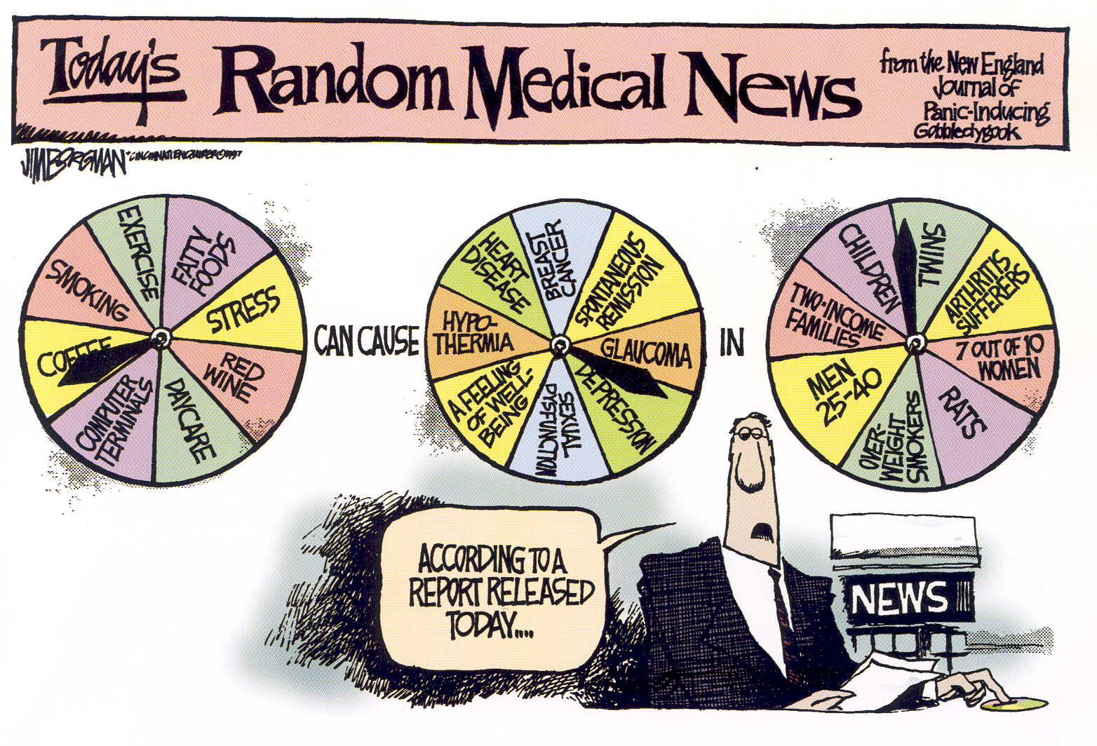
Science is Imperfect
Source: Borgman, J (1997). The Cincinnati Enquirer. King Features Syndicate.
Notes:
To some, conflicting results from different epidemiologic studies can be confusing. This cartoon illustrates random cause-effect relationships in groups of people. Rest-assured, epidemiologists do not spin a wheel to decide what exposures cause what diseases! Epidemiologists first examine preliminary evidence, then form hypotheses, and then test those hypotheses.

Slide 13
Types of Epidemiology
Descriptive Epidemiology
Surveillance (Shoe-leather Epidemiology)
Clinical Epidemiology
Nutritional Epidemiology
Social Epidemiology
Molecular Epidemiology
Predictive Epidemiology
Veterinary Epidemiology
Industrial Epidemiology
Etc…

Slide 14
Epidemiologic Approaches
DESCRIPTIVE
ANALYTICAL
What? | Who? | When? | Where?
What are the health problems? | How many people are affected? | Over what period of time? | Where do affected individuals live, work, play?
What are the attributes of these illnesses? | What are the attributes of affected persons?
Why? | How?
What are the causal agents? | By what mechanism do they operate?
What factors affect outcome?

Slide 15
Descriptive Epidemiology
Provides systematic method for characterizing health problems
What happens
Which population it happens in
When it happens
Identifies populations at higher risk
Helps with allocation of resources
Enables development of testable hypotheses
Main characteristics are person, place and time

Slide 16
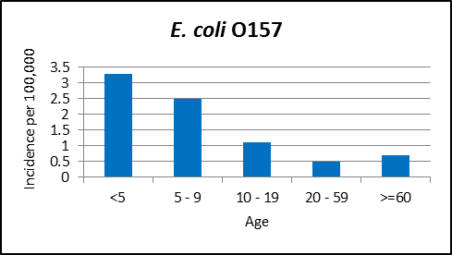
Person
Typically includes
Age
Race/Ethnicity
Sex
Education
Occupation
Socio-economic status
May be shown in tables or graphs

Slide 17
Place

Slide 18
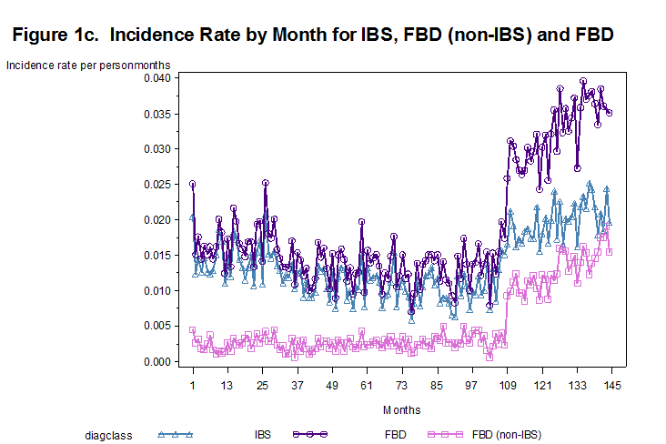
Time

Slide 19
Surveillance
Ongoing systematic collection, recording, analysis, interpretation, and dissemination of data reflecting the current health status of a community or population.
Establishes baseline rate of disease.
Estimates magnitude of problem and geographic distribution.
Used to detect outbreaks/epidemics.
Can be passive or active.
Extends beyond infectious diseases.
Critical to prevention!

Slide 20
Analytic Epidemiology
Focuses on “why” and “how”.
Basic question: Are exposure and outcome linked?
Exposure – any factor that might influence risk of disease.
Outcome – disease or health-related event of interest.
Objectives
Quantify association between exposures and outcomes
Test hypotheses about causal relationships
Comparison group is key feature.

Slide 21
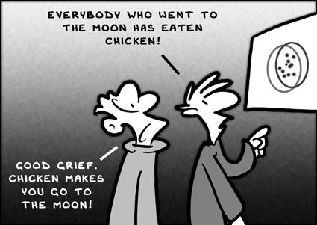
Association ≠ Causation

Slide 22
Designing Epidemiologic Studies

Slide 23
Epidemiologic Approaches
DESCRIPTIVE
ANALYTICAL
What? | Who? | When? | Where?
What are the health problems? | How many people are affected? | Over what period of time? | Where do affected individuals live, work, play?
What are the attributes of these illnesses? | What are the attributes of affected persons?
Why? | How?
What are the causal agents? | By what mechanism do they operate?
What factors affect outcome?

Slide 24
Epidemiologic Study Designs
Epidemiologic Studies
Analytic
Quasi-Experimental
Randomized Controlled Trial
Cohort
Case-Control
Cross-Sectional
Ecological
Descriptive
Case Reports
Case Series
Observational
Experimental

Slide 25
Descriptive Epidemiology
Provides systematic method for characterizing problems
What happens
Which population it happens in
When it happens
Identifies populations at higher risk
Helps with allocation of resources
Enables development of testable hypotheses
Main characteristics are person, place and time

Slide 26
Case Reports and Case Series
Case is an instance of a disease or problem.
Case reports describe experience of single case.
Case series is collection of individual case reports.
Generally report on new/unique condition.
Useful for hypothesis generation.
Informative for rare events with few known risk factors.
Descriptive, not measure of occurrence!
No comparison group – cannot study associations!

Slide 27
Epidemiologic Study Designs
Epidemiologic Studies
Analytic
Quasi-Experimental
Randomized Controlled Trial
Cohort
Case-Control
Cross-Sectional
Ecological
Descriptive
Case Reports
Case Series
Observational
Experimental

Slide 28
Analytic Epidemiology
Focuses on “why” and “how”.
Basic question: Are exposure and outcome linked?
Exposure – any factor that might influence risk of outcome
Outcome – event of interest
Objectives
Quantify association between exposures and outcomes
Test hypotheses about causal relationships
Comparison group is key feature.

Slide 29
Observational Studies
Non-experimental
Exposure status or intervention not assigned
Difficult to replicate
Less control of study environment, may result in bias
Can only be used to study associations
May present less ethical issues

Slide 30
Experimental Studies
Planned research design
Exposure status or intervention assigned by investigators
Easier to replicate
Study environment more controlled, may result in less bias
Can be used to evaluate cause-effect
May present more ethical issues

Slide 31
Ecological (Correlational) Study
Unit of study is population or community, not individual
Exposure and outcome rates measured in series of populations
Explores correlation between aggregated exposure and outcome data
Low cost, quick and convenient – often uses existing data
Useful for exposures that cannot be measured individually (i.e. air pollution, drinking water)
Limited data on other factors associated with outcome (confounding)
Cannot link exposure with outcome in individual (ecological fallacy)
Difficult to interpret, weakest form of evidence

Slide 32

Ecological Fallacy
Occurs relationships observed for groups are assumed to hold for individuals in the groups.
Example: In 1800’s, Émile Durkheim (1858 –1917) found that suicide rates were higher in countries that were predominately Protestant. Durkheim concluded that Protestants are more likely to commit suicide!

Slide 33
Cross-Sectional Study
Exposure and outcome status are determined at same time (“snapshot” or “cross-section”)
Unit of study is individual
Measures prevalence, not incidence.
Examines association, not causation.
Difficult to establish temporal sequence (which came first: exposure or outcome).
Not suitable for rare/high mortality diseases or diseases with short duration

Slide 34
Cross-Sectional Study Design
Study
Population
Outcome
Factor present
Factor absent
Factor present
Factor absent
No
Outcome
Measured at specific point in time
TIME

Slide 35
Cohort Study
Compares individual with known exposure (or risk factor) with those without.
Unit of study is individual.
Exposure status determined before outcome detection.
Individuals grouped according to exposure, followed to determine if they develop outcome.
Looking for difference in risk (incidence) in outcome over time.
Best observational design

Slide 36
Cohort Study Design
Study
Population
Exposed
Outcome
No
Outcome
Outcome
No
Outcome
Not
Exposed
TIME
Prospective
Retrospective

Slide 37
Cohort Study Design
Strengths | Study new or rare exposures Maintains temporal sequence Examine multiple outcomes Minimizes bias in exposure measurement Directly measures of incidence, relative risk
Limitations | Not feasible for rare events or events with long latency Requires large sample sizes Expensive and time-consuming (prospective) Inadequate records (retrospective) Potential loss to follow-up

Slide 38
Case-Control Study
Compares exposures in individuals with outcome (cases) with individuals without outcome (controls).
Unit of study is individual.
Exposure data collected retrospectively.
Individuals grouped according to outcome.
Compare frequency of exposure among cases and controls.
Cannot calculate incidence because study does not follow outcome-free population over time.
Estimates odds ratio rather than relative risk.

Slide 39
Case-Control Study Design
Factor Present
Outcome (cases)
Factor Absent
Study
Population
Factor Present
No Outcome (controls)
Factor Absent
TIME

Slide 40
Case-Control Study Design
Strengths | Efficient for studying rare events Less expensive and time consuming Examine multiple risk factors
Limitations | Must know outcome for exposure at start of study Exposure measurements taken after outcome occurs Inefficient for rare exposure Susceptible to bias Cannot measure incidence, relative risk

Slide 41
Cohort vs Case-Control
 | Cohort Study | Case-Control Study
Preferred study design when… | Population members are easily identifiable Members are easily accessible Exposure is rare There may be multiple outcomes involved | Identifying and/or accessing entire cohort would be too costly or time consuming Outcome is rare
Study group | Exposed individuals | Individuals with outcome (cases)
Comparison group | Non-exposed individuals | Individuals without the outcome (controls)

Slide 42
Epidemiologic Study Designs
Epidemiologic Studies
Analytic
Quasi-Experimental
Randomized Controlled Trial
Cohort
Case-Control
Cross-Sectional
Ecological
Descriptive
Case Reports
Case Series
Observational
Experimental

Slide 43
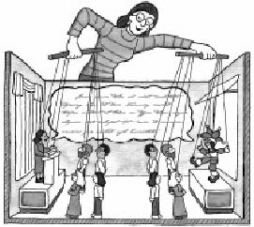
Experimental Studies
Three main characteristics
Manipulation of exposure to observe effect on outcomes
Control of effects of extraneous (lurking) variables on outcome by using control (no exposure) group
Randomization to ensure that every study unit has an equal chance of being assigned to the exposure
Considered most powerful designs
Can establish causality
Disadvantages
May not be practical (ethical concerns)
May not be representative of “real world”

Slide 44
Types of Experimental Design
 | PE | QE | TE
Control Group | Usually not | Often | Always
Random selection of subjects from population | No | No | Yes
Random assignment of subjects to groups | No | No | Yes
Random assignment of treatment to groups | No | No | Yes
Control over extraneous variables | None | Some | Yes
Evidence of causality | Weak | Weak/ Moderate | Strong
Pre – Experimental
One-shot case study
One group pre-test – post-test
Static group
Quasi – Experimental
Non-randomized controlled study
Time Series
True Experimental
Pre-test – post-test control group
Post-test only control group
Solomon Four Group
Randomized block
Latin Square
Factorial Design

Slide 45
Randomized Controlled Trial
An epidemiological experiment in which subjects in a population are randomly allocated into groups, usually called study and control groups to receive and not receive an experimental preventive or therapetuic procedure, maneuver, or interventition [Last, 2001].
”Gold standard” in epidemiological research
Allows examination of causation
Controls for confounding (known and unknown)
Prevents selection bias
Sometimes presents ethical issues

Slide 46
Randomized Controlled Trial
Randomized
Study
Groups
Intervention
Outcome
No Outcome
Outcome
No Outcome
No Intervention
Randomization
TIME

Slide 47
Some Variations
Post-Test Only
Random
Assignment
Experimental Group
Treatment
Post-Test
No
Treatment
Post-Test
Control
Group
Pre-Test – Post-Test Only
Random
Assignment
Experimental Group
Pre-Test
Treatment
Pre-Test
No
Treatment
Control
Group
Post-Test
Post-Test
Random
Assignment
Experimental Group 2
Pre-Test
Treatment
Pre-Test
No
Treatment
Control
Group 2
Post-Test
Post-Test
Experimental Group 1
Treatment
Post-Test
Control
Group 1
No
Treatment
Post-Test
Solomon Four-Group Design

Slide 48
Randomized Block Design
Units or Subjects
Block 2
Treatment
No
Treatment
Random
Assignment
Post-Test
Post-Test
Block 1
Random Assignment
Treatment
Post-Test
No Treatment
Post-Test

Slide 49
Quasi-Experimental Study Design
Similar to experimental design but lacks randomization or control group
Generally used in situation where cannot randomly assign exposure (treatment) but want to establish causality
Allows evaluation of outcomes in natural setting (“real world”)
Disadvantages
No control over extraneous (lurking) variables
Less reliable results
Weaker evidence for causality
Types of Quasi-Experimental Studies
Non-randomized control group
Time-series

Slide 50
Quasi-Experimental Study Designs
Non-randomized Control Group Design
Experimental Group
Measurement
Treatment
Measurement
Matching?
Control Group
Measurement
No
Treatment
Measurement
Time Series Study Design
Experimental Group
Measurement
Measurement
Treatment
Measurement
Measurement

Slide 51
Strength of Evidence
Ecologic
Cross-Sectional
Case-Control
Cohort
Randomized Trial
$ $$$$
Least Informative Most Informative
Generate Hypotheses Establish Causality

Slide 52

Systematic Literature Review
Methodical and comprehensive literature synthesis focused on well-formulated research question
Procedures are defined in advance
Clear inclusion and exclusion criteria
Explicit search strategy
Systematic assessment of study quality
Process is transparent and reproducible
Designed to minimize bias
Literature
Systematic Review

Slide 53
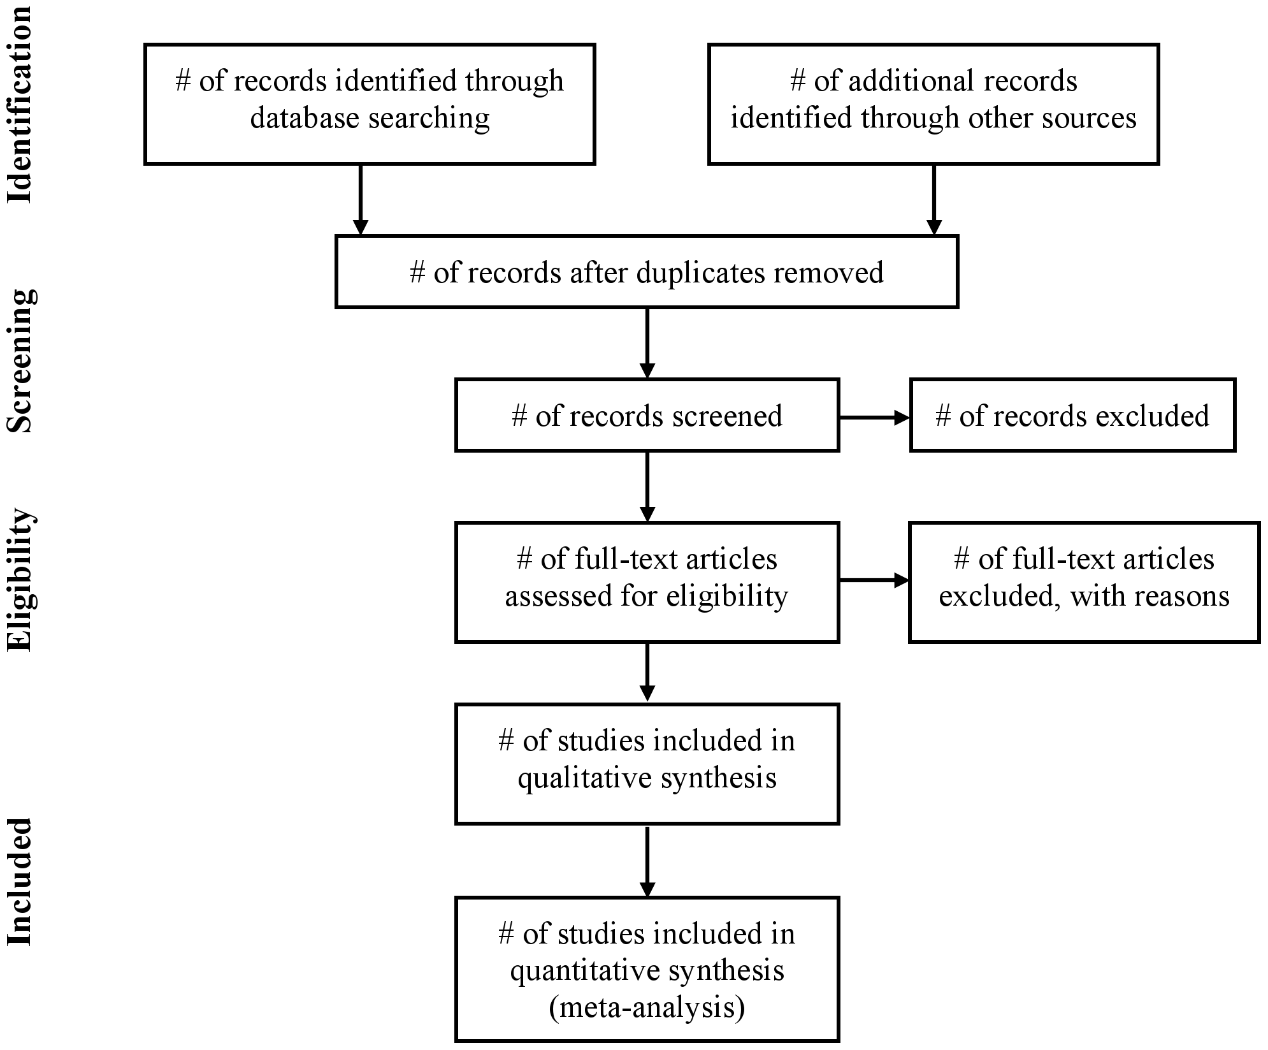
Phases of a Systematic Review
Source: Liberati et al. PLoS Med 6(7): e1000100. https://doi.org/10.1371/journal.pmed.1000100

Slide 54
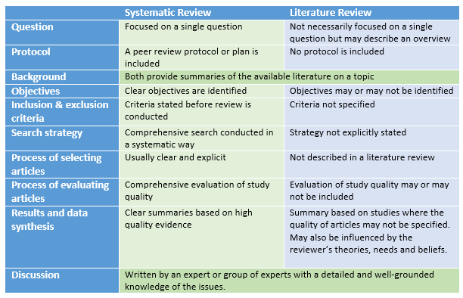
Systematic versus Traditional Literature Review
Source: Curtin University Library

Slide 55
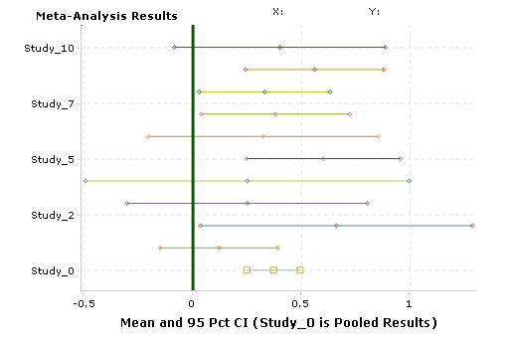
Meta-Analysis
Quantitative approach for systematically combining results of previous research to arrive at conclusions about body of research.
Unit of study is each study.
Steps:
Review literature
Extract data
Analyze results
Obtain pooled estimate
Provide evidence base
Study 1
Study 2
Study 3
Combined Results

Slide 56
Hierarchy of Scientific Evidence
Ideas, expert opinions, editorials
Anecdotal Evidence
RCTs
Case control studies
Cross-sectional surveys
Case reports or series
Laboratory and animal studies
Cohort Studies
Quasi-Experimental
Meta Analysis
Systematic Review
Strength of Evidence

Slide 57
Bradford Hill Criteria
Criteria | Definition
Strength | Strong relationship between exposure and outcome.
Consistency | Findings are consistent across studies and populations.
Specificity | Outcome is specifically result of exposure.
Temporality | Exposure precedes outcome.
Dose-Response | Direct relationship between exposure and outcome.
Plausibility | Rational and theoretical basis for explaining how the exposure can cause the outcome.
Coherence | Association does not conflict with known facts.
Experimental Evidence | Experimental evidence suggests changing exposure changes outcome.
Analogy | Similar to other known exposure-outcome associations.

Slide 58
Name that Study Design
Researchers want to describe the microbiota of milk from healthy and inflamed bovine mammary glands from dryoff through 150 days. Mammary gland quarters of all cows in a dairy herd were screened for potential enrollment. Weekly milk samples were collected for enrolled quarters.
The food histories of individuals sickened in a salmonellosis outbreak are compared to healthy individuals to identify potential food vehicles.
Establishments are randomly assigned to one of two training interventions. The number of product defects is measured pre- and post-training in each establishment to assess the impact of the training.
Consumers were randomly selected outside a supermarket. Each participant completed a questionnaire on their knowledge and consumption of functional foods.

Slide 59
Sampling Strategies

Slide 60
Sampling
A sample is a smaller collection of units from a population used to estimate characteristics about an entire population.
A census is when data is gathered on every member of the population.
Why sample?
Resources and workload
Gives results with known accuracy that can be calculated mathematically.
Representativeness is key.

Slide 61
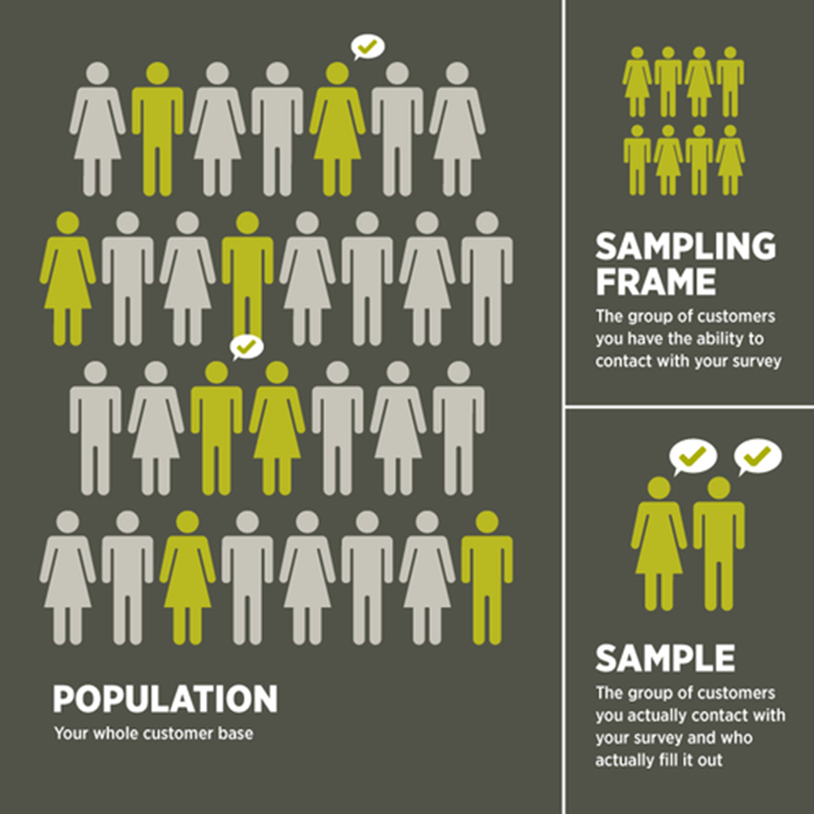
Populations and Samples
Population: collection of all elements we wish to make an inference about
Sampling frame: list of all the sampling units from which sample is drawn
Sampling Unit: smallest unit from which sample can be selected
Element: object on which a measurement is taken
Inferences only apply to defined population from which the sample has been selected

Slide 62
Representativeness
Sample should be representative of the target population so you can generalize to population.
Representative samples accurately reflect entire population (i.e. a group that closely matches the characteristics of its population as a whole).
Randomly selected samples produce sample statistics that are unbiased estimates of population parameters.
Random sampling is when all elements in population have equal chance of being selected.
Factors that influence sample representativeness
Sampling procedure
Sample size
Nonresponse

Slide 63
Sampling Process
Define Target Population
Define population of interest
Specify sampling frame
Specify sampling method (scheme) for selecting sampling units from sampling frame
Determine sample size
Implement sampling plan
Sample and collect data
Review sampling process
Determine Sampling Frame
Select Sampling Strategy
Determine Sample Size
Select
Sample
Review Sampling Process

Slide 64
Types of Sampling
Probability Samples: each member of the population has a known non-zero probability of being selected
Allows application of statistical sampling theory to results to generalize results and test hypotheses
Nonprobability Samples: members are selected from the population in some nonrandom manner
Probability of being chosen is unknown
Cheaper- but unable to generalise
potential for bias

Slide 65
Probability Sampling
Simple Random
All elements have equal chance of being selected
Systematic
Randomly select first item from first n elements and pick every nth element in succession
Cluster
Population divided into clusters and random sample selected from each cluster
Stratified
Population is divided into mutually exclusive subgroups (stratum) and elements are randomly selected from each stratum

Slide 66
Simple Random Sampling
Sampling units are randomly selected from sampling frame using random number table or “lottery” system
Each sampling unit has an equal probability of being selected
Advantages
Purest form of probability sampling
Straightforward
Estimates are easy to calculate
Disadvantages
If sampling frame large, this method impracticable.
Subgroups in population may not be present in sample in sufficient numbers

Slide 67
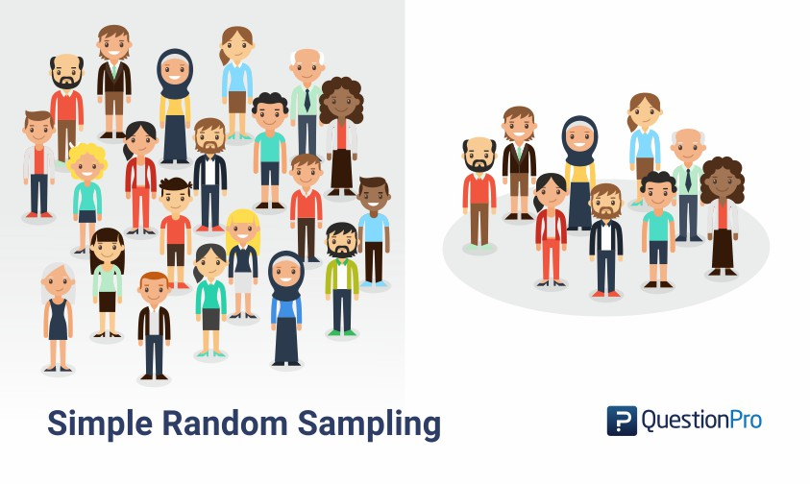

Slide 68
Systematic Sampling
Each member of the population is assigned a number and kth element is selected
Starting point randomly chosen from first kth elements
Advantages
Sample easy to select
Suitable sampling frame can be identified easily
Sample evenly spread over entire reference population
Disadvantages
Sample may be biased if hidden periodicity in population coincides with that of selection.
Difficult to assess precision of estimate from one survey.

Slide 69
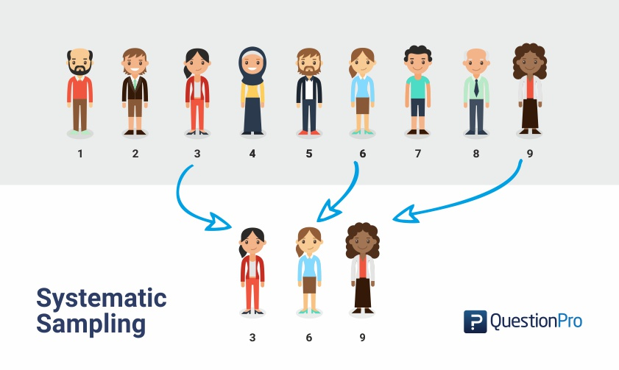

Slide 70
Stratified Sampling
Elements sampled from mutually exclusive subgroups of population to ensure each segment of population is represented
Stratum is subset of population that share at least one common characteristic
Method
Sampling frame is organized into separate strata
Each stratum is sampled as independent subpopulation
Sample elements from each stratum
Using same sampling fraction for all strata ensures proportionate representation in sample.
Superior to random sampling because it reduces sampling error
Often used when >1 stratums have low incidence relative to other stratums
Often requires larger sample size

Slide 71
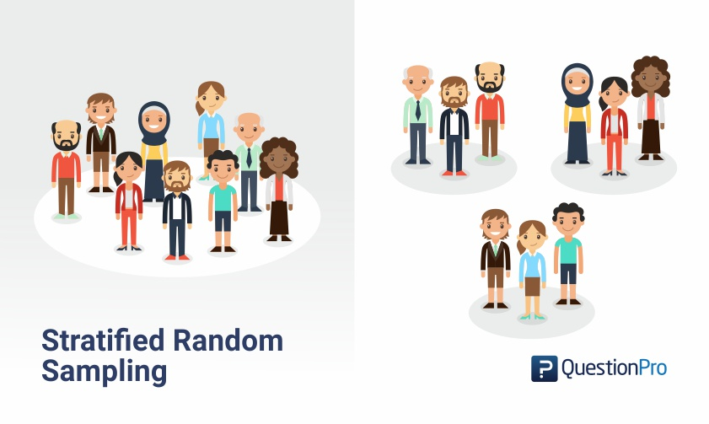

Slide 72
Cluster Sampling
Each sampling unit is collection, or cluster, of elements
Used when population falls into naturally occurring subgroups.
Process
Population divided into clusters of homogeneous units, usually based on geographical contiguity.
Sample of clusters selected
All elements from selected clusters are sampled
Examples of clusters:
City blocks – political or geographical
Housing units – college students
Hospitals – illnesses
Automobile – set of four tires

Slide 73
Cluster Sampling
Effective when:
Good sampling frame not available or costly but frame listing clusters is easily obtained
Cost of sampling increases as distance separating elements increases
Advantages
Cuts down on cost of preparing sampling frame
Can reduce travel and other administrative costs
Disadvantages
Sampling error is higher than for simple random sample of same size

Slide 74
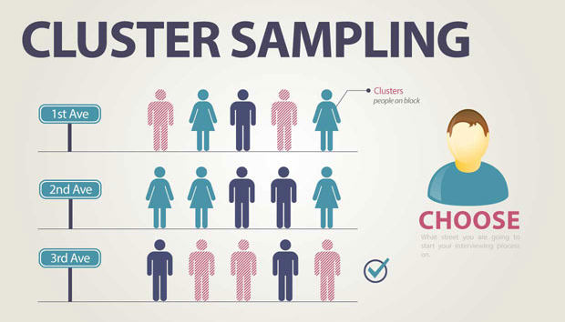

Slide 75
Strata vs. Clusters
Strata and clusters are both non-overlapping subsets of population
Stratified sampling
All strata are represented in the sample
Best when elements within strata are homogeneous
Cluster sampling
Only a subset of clusters are in the sample
Best when elements within clusters are heterogeneous

Slide 76
Matched Random Sampling
Elements are matched in pairs based on some characteristic and then randomized
Attributes or variables measured twice on each element under different circumstances
Commonly called repeated measures.
Examples
1500m times for group of athletes for before and after week of special training
Milk yields of cows before and after being fed particular diet.

Slide 77
Non-Probability Sampling
Convenience
Based on ease of accessibility
Judgemental
Deliberately select sample to conform to some criteria
Snowball
Referred by current sample elements
Quota
Relevant characteristics used to segregate sample

Slide 78
Convenience Sampling
Sample is selected because they are convenient
Used in exploratory research where the researcher is interested in getting an inexpensive approximation.
Advantages
Convenient, saves time and money
Useful for preliminary research
Disadvantages
Cannot scientifically make generalizations about the total population
Potential for selection bias

Slide 79
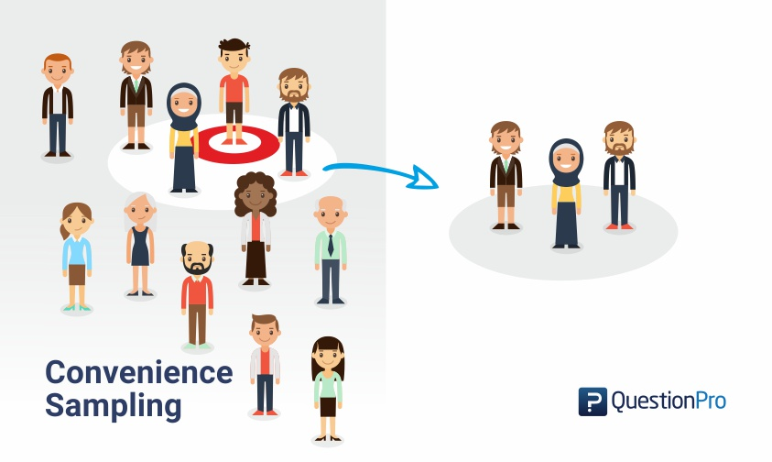

Slide 80
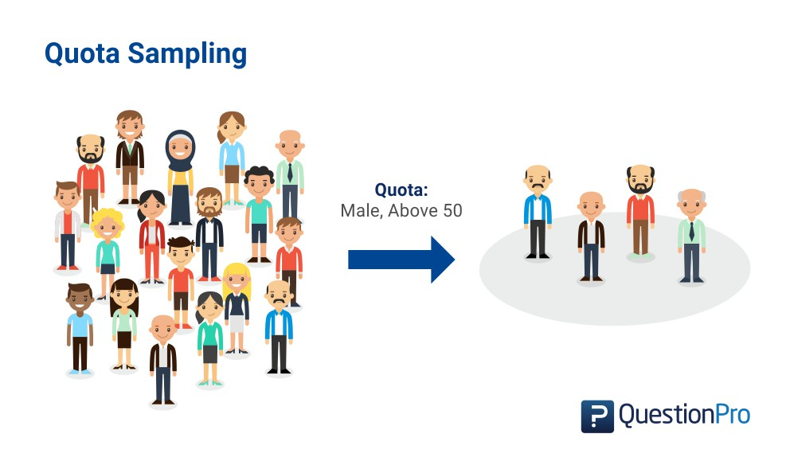

Slide 81
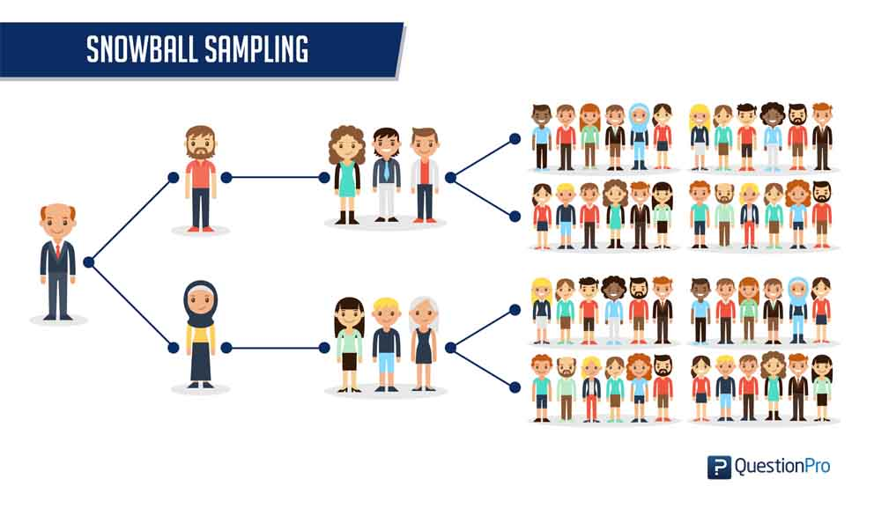

Slide 83
Let’s Practice…
Determining the number of years of education each teacher at your college has.
You randomly select two different departments and survey each teacher in those departments.
You select only the teachers you currently have this semester.
You divide the teachers up according to their department and then choose and survey some teachers in each department.
Determining proportion of undernourished five year olds in a village.
Investigating nutritional status of preschool children.

Slide 84
Understanding Error

Slide 85
“To Err is Human”
Error is discrepancy between observed result and true value
All studies have many, many opportunities for error in relation to:
Selection of study participants
Classification and measurement
Comparison and interpretation
Good study designs protect against errors!

Slide 86
Technical Terms
Random error: sampling variability
Systematic error (bias): error in design, conduct, or analysis of study
Accuracy: lack of error – getting the correct result
Precision: absence of random error
Reliability: repeatability of a measure
Validity: absence of bias (or absence of all error)
Internal validity: study provides unbiased estimate of what it claims to estimate
External validity: study results can be generalized to some other population

Slide 87
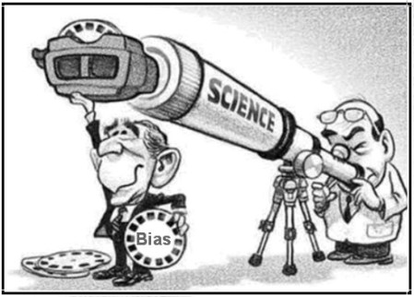
What is Bias?
Any trend in collection, analysis, interpretation, publication, review of data that can lead to conclusions that are systematically different from the truth [Last, 2001].
Built into the study design
May be present without investigator being aware
Sources may be difficult to identify
Influence may be difficult to assess
Potential biases must be considered and addressed

Slide 88
Types of Bias
Selection Bias
Differential access to the study population
Sample is not representative
Includes loss to follow up, self-selection bias
Information/Measurement/Misclassification Bias
Inaccuracy in measurement or classification
Includes recall bias, reporting bias
Confounding
Distortion of association due to another factor (i.e. unfair comparison)

Slide 89
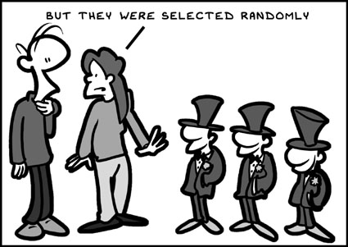
Selection Bias
Occurs when selection, enrollment, or continued participation is dependent on likelihood of exposure or outcome
Results in study groups being non-comparable
Sample is not representative

Slide 90
Examples of Selection Bias
Self-selection bias – refusal, non-response, or agreement to participate is related to exposure
Responders often differ systematically from non-responders
Detection bias – exposure affects sample selection
Survival bias – due to death, illness, migration
Attrition bias – likelihood of being lost to follow up is related to outcome status and exposure status
Healthy worker effect – workers are often healthier than other population segments

Slide 91
Information/Measurement Bias
Information bias (observational bias) – systematic differences in the way in which data on exposure and outcome are obtained from the various study groups.
Main types of information bias
Recall bias
Interviewer/observer bias
Misclassification bias

Slide 92
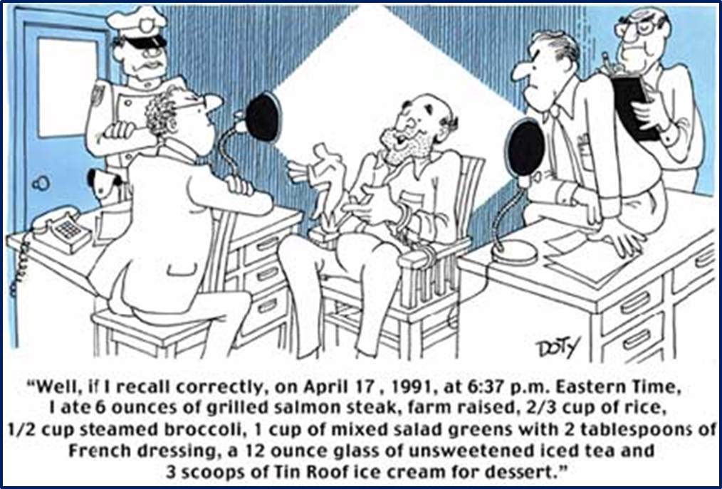
Recall Bias
Systematic differences in the way subjects remember or report exposures or outcomes
Self-reported information is particularly susceptible
Individuals who have experienced outcome may tend to think about possible “causes” of outcome (differential recall)

Slide 93
Interviewer Bias
Systematic difference in the soliciting, recording, or interpretation of information from study participants
Observers may have preconceived expectations of what they should find in an examination
Interviewers have a direct and dramatic effect on responses to a question.
Interviewer’s knowledge may influence structure of questions and manner of presentation, which may influence responses
People tend to side with view apparently favored by interviewer, especially if they are neutral
Friendly interviewers are more successful
Interviewers of same gender, racial, and ethnic groups as those being interviewed are slightly more successful

Slide 94
Misclassification Bias
Misclassification bias – errors are made in classifying either exposure or outcome
Nondifferential (random) misclassification – errors in exposure or outcome status occur with approximately equal frequency in groups being compared.
Differential misclassification – more frequent errors in exposure or outcome classification in one of the groups.
Non-differential misclassification better than differential

Slide 95
Other Types of Information Bias
Reporting bias – selective suppression or revealing of information
Occurs when subject reluctant to report exposure due to attitudes, beliefs, and perceptions
“Wish bias” may occur among subjects who seek to show that outcome “is not their fault.”
Hawthorne effect – effect first documented at a Hawthorne manufacturing plant; people act differently if they know they are being watched
Surveillance bias – group with known exposure or outcome may be followed more closely or longer than others

Slide 96
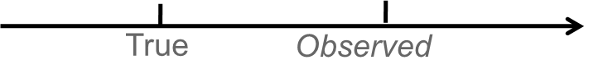
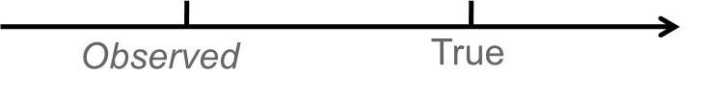
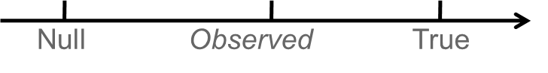
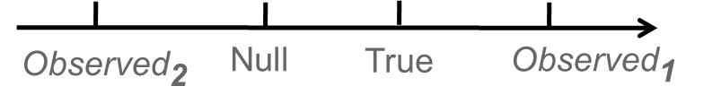
Effects of Bias
Positive bias – observed value is higher than the true value
Negative bias – observed value is lower than the true value
Bias towards the null – observed value is closer to 1.0 than is the true value
Bias away from the null – observed value is farther from 1.0 than is the true value

Slide 97

Effects of Bias
Non-Differential
Misclassification
Errors
Errors
Selection bias
Recall
Bias
0.3 1.0 2 3
Errors
Interviewer bias
Bias to Null
Errors
Differential
Misclassification
0.3 1.0 2 3

Slide 98
Controlling Bias
Prevention is key
Once it’s in the study, you can’t fix it!
Select subjects by similar mechanism
Be purposeful in the study design to minimize the chance for bias
Define categories clearly a priori so there is no overlap
Collect data accurately and in similar way
Train observers or interviewers to obtain data in same fashion
Preferable to use >1 observer or interviewer but must be trained in identical manner

Slide 99
Controlling Bias
Randomly allocate observer and interviewer data collection assignments
Use masking
Single masked study – subjects are unaware of whether they are in the experimental or control group
Double masked study – the subject and the observer are unaware of the subject’s group allocation
Triple masked study – the subject, observer and data analyst are unaware of the subject’s group allocation
Use procedures to minimize loss to follow-up

Slide 100
Confounding
Creates appearance of cause-effect relationship when one does not actually exist.
Confounding variable is associated with both exposure and outcome being studied.
Confounding occurs when effects of two exposures (or risk factors) have not been separated.
Difficult to control and can greatly influence results.
Always need to question if confounders are present.

Slide 101
Confounding – An Example

Slide 102
Mediating and Modifying Variables
Not every factor that is associated with both exposure and outcome is a confounding variable
A mediator is associated with both independent and dependent variables, but is part of causal chain between the independent and dependent variables.
A moderator is modifies the way in which exposure and outcome are related.
Need to understand underlying science or process.

Slide 103
Controlling Confounding
Potential confounders should be considered during study design.
Randomization attempts to evenly distribute potential confounders.
Matching ensures equal representation of individuals with known confounders in comparison groups.
Stratification and standardization (adjusted) can be used to control confounding in analysis phase (i.e. crude vs. adjusted rates).

Slide 104
Likelihood of Bias by Study Design
Probability of | Ecological | Cross-Sectional | Case-Control | Cohort
Selection bias | N/A | Medium | High | Low
Recall bias | N/A | High | High | Low
Loss to follow-up | N/A | N/A | Low | High
Confounding | High | Medium | Medium | Medium
Time Required | Low | Medium | Medium | High
Cost | Low | Medium | Medium | High

Slide 105

Questions?

